Slide 1
TITLE PAGE
Project Title : RED EYE GUARD APPLICATION
Author of Project : ERIC ANTHONY KAMAU
This progress presentation has been submitted to the Department of Information of Technology in the School of Computer Science and Information Technology in partial fulfillment of the requirements for the award of degree in Bachelor of Science Information Technology at Dedan Kimathi University of Technology.
AUGUST 2024

Slide 2
INTRODUCTION
System testing is a process of testing the entire system that is fully functional, in order to ensure the system is bound to all the requirements provided by the client in the form of the functional specification or system specification documentation.
While testing my system, I used various techniques for testing to ensure a verifiable procedure of development and giving valid output as per the statement of the functional and non-functional requirements.
Testing was achieved from the smallest to the largest modules of the system to understand the requirements of the system

Slide 3
ABSTRACT
Red Eye disease is a big problem because it makes people's eyes red, itchy, and uncomfortable.
This eye condition happens for many reasons, like infections, allergies, or things like chemicals irritating the eyes.
It can make it hard for people to go about their daily activities and can even lead to serious eye problems if not treated properly.
Red Eye Guard is a new application for Android phones that will help people with Red Eye disease.
The application has many helpful features to detect, treat, and prevent Red Eye disease.

Slide 4
Problem Statement
One of the main issues with Red Eye disease is that it's sometimes hard to figure out what's causing it.
There are different types of Red Eye, and the symptoms can be similar, so it's not always easy to know the right treatment. Plus, not everyone has easy access to eye doctors or knows what to do when their eyes start feeling irritated.
This means some people might not get the help they need, which can make the problem worse and lead to more serious complications.
The introduction of this Red eye guard will help many people not only locally but even externally ,making it very reliable to curb this Red Eye disease.

Slide 5
OBJECTIVES
To develop an application (Red Eye Guard) in order to leverage technology and community engagement to enhance early detection, timely treatment, and required recommendations for individuals affected by the Red Eye disease, ultimately improving outcomes and reducing the burden of the condition.

Slide 6
SPECIFIC OBJECTIVES
Allow users to and check their eye health status.
To create and train a model to predict the Red eye disease.
Allow users to upload their images to detect Red Eye disease.
Give users recommendations for protecting against Red eye disease.
Allows users to book appointments with available doctors and have a payment platform.
Rate the application.

Slide 7
METHODOLOGY
To train the model I have used Convolutional Neural Network (CNN)architecture for image processing and integration into my application.
This was done by converting the model from.h5 to tflite.
To build the application I have used Android Studio.
Use of a USB cable to launch the application into devices.

Slide 8
REQUIREMENTS
Internet Connectivity
USB Cable
Laptop (emulator)
Mobile phone

Slide 9
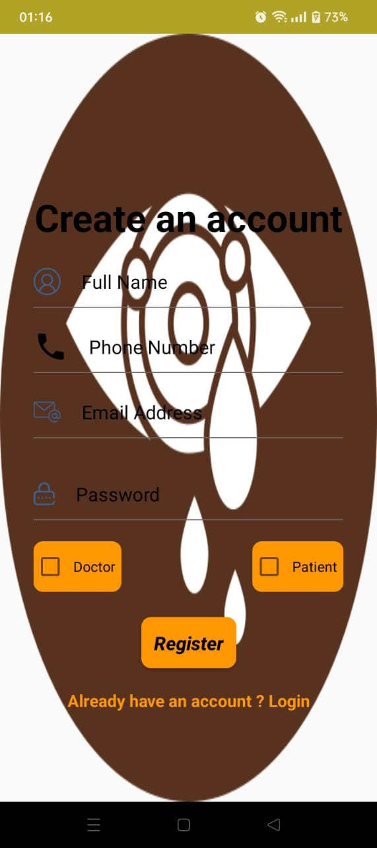
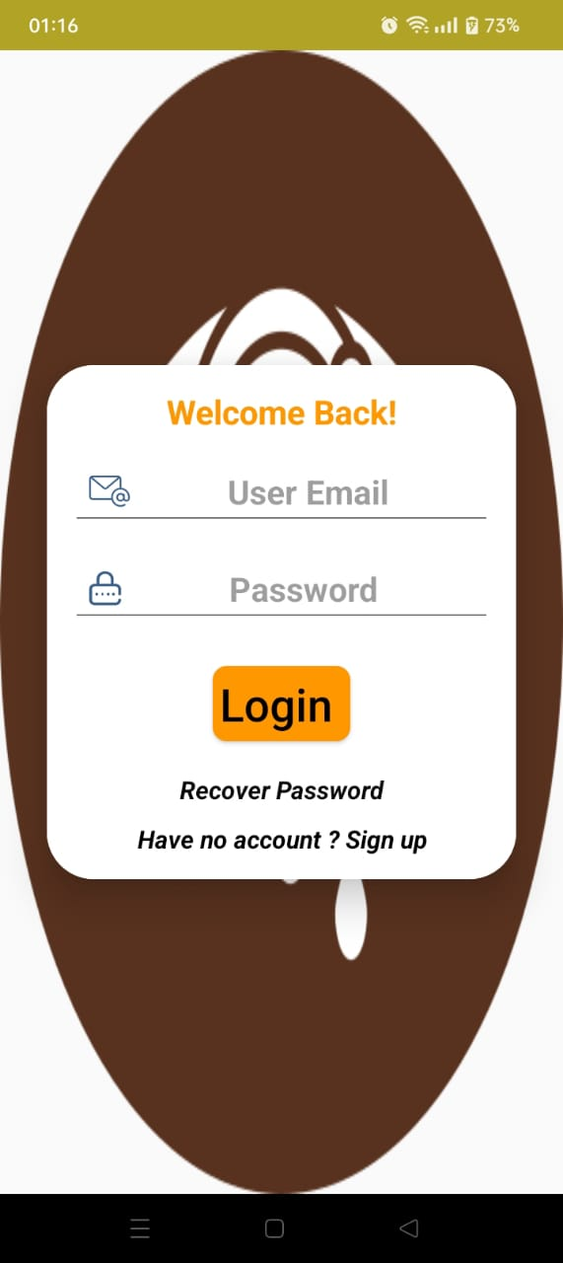
DEMO IMAGES

Slide 10
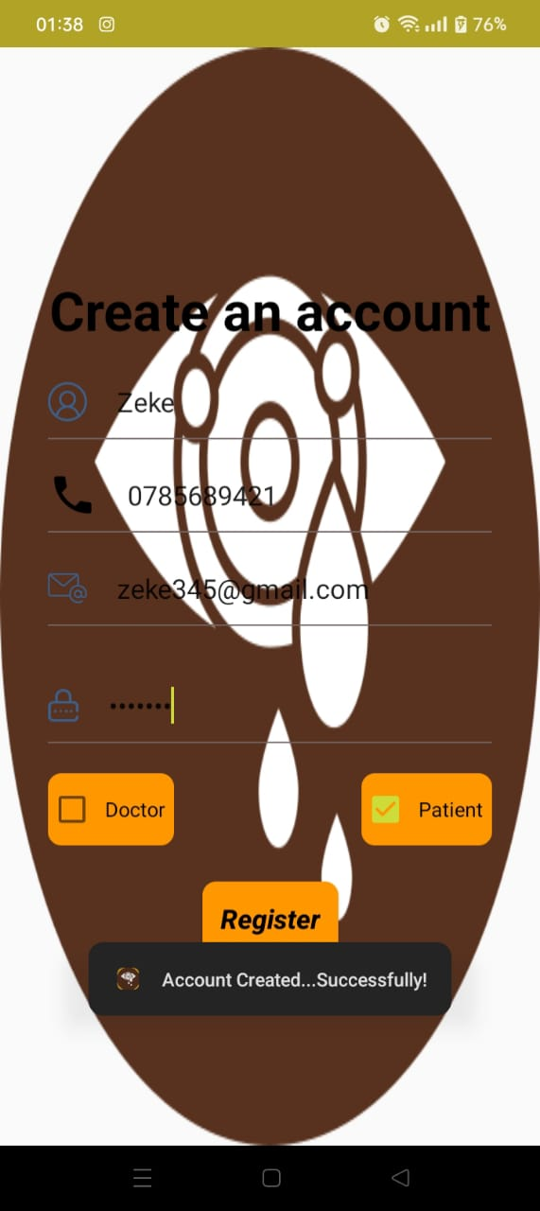
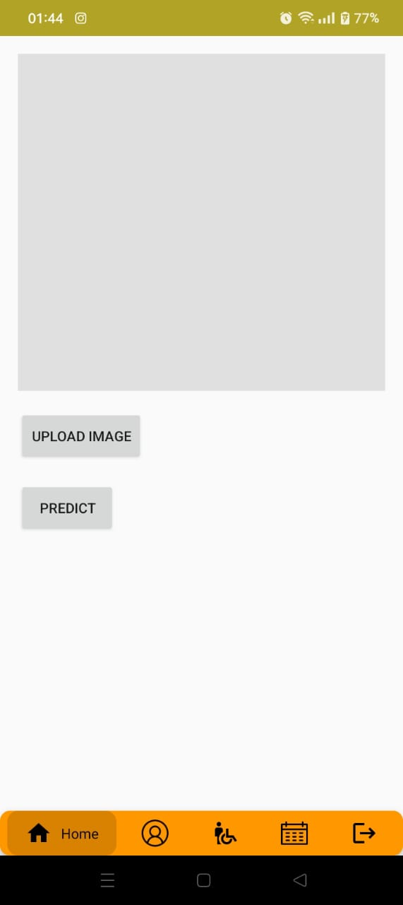
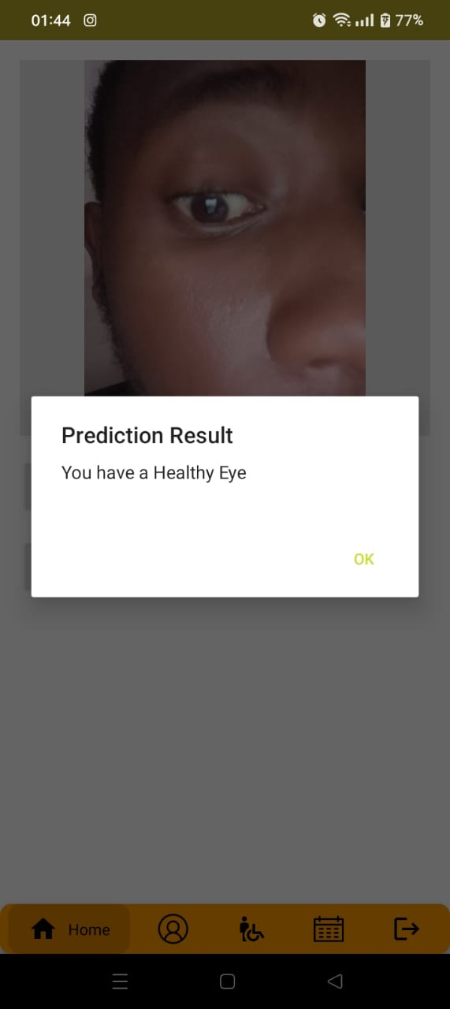
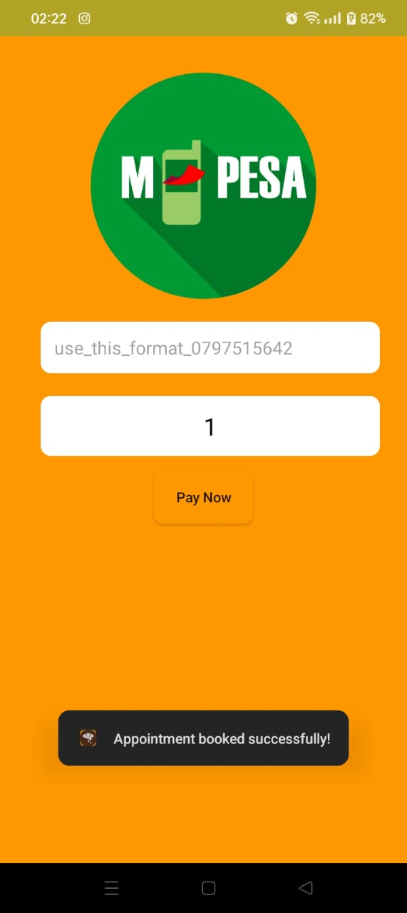
DEMO IMAGES

